Slide 1
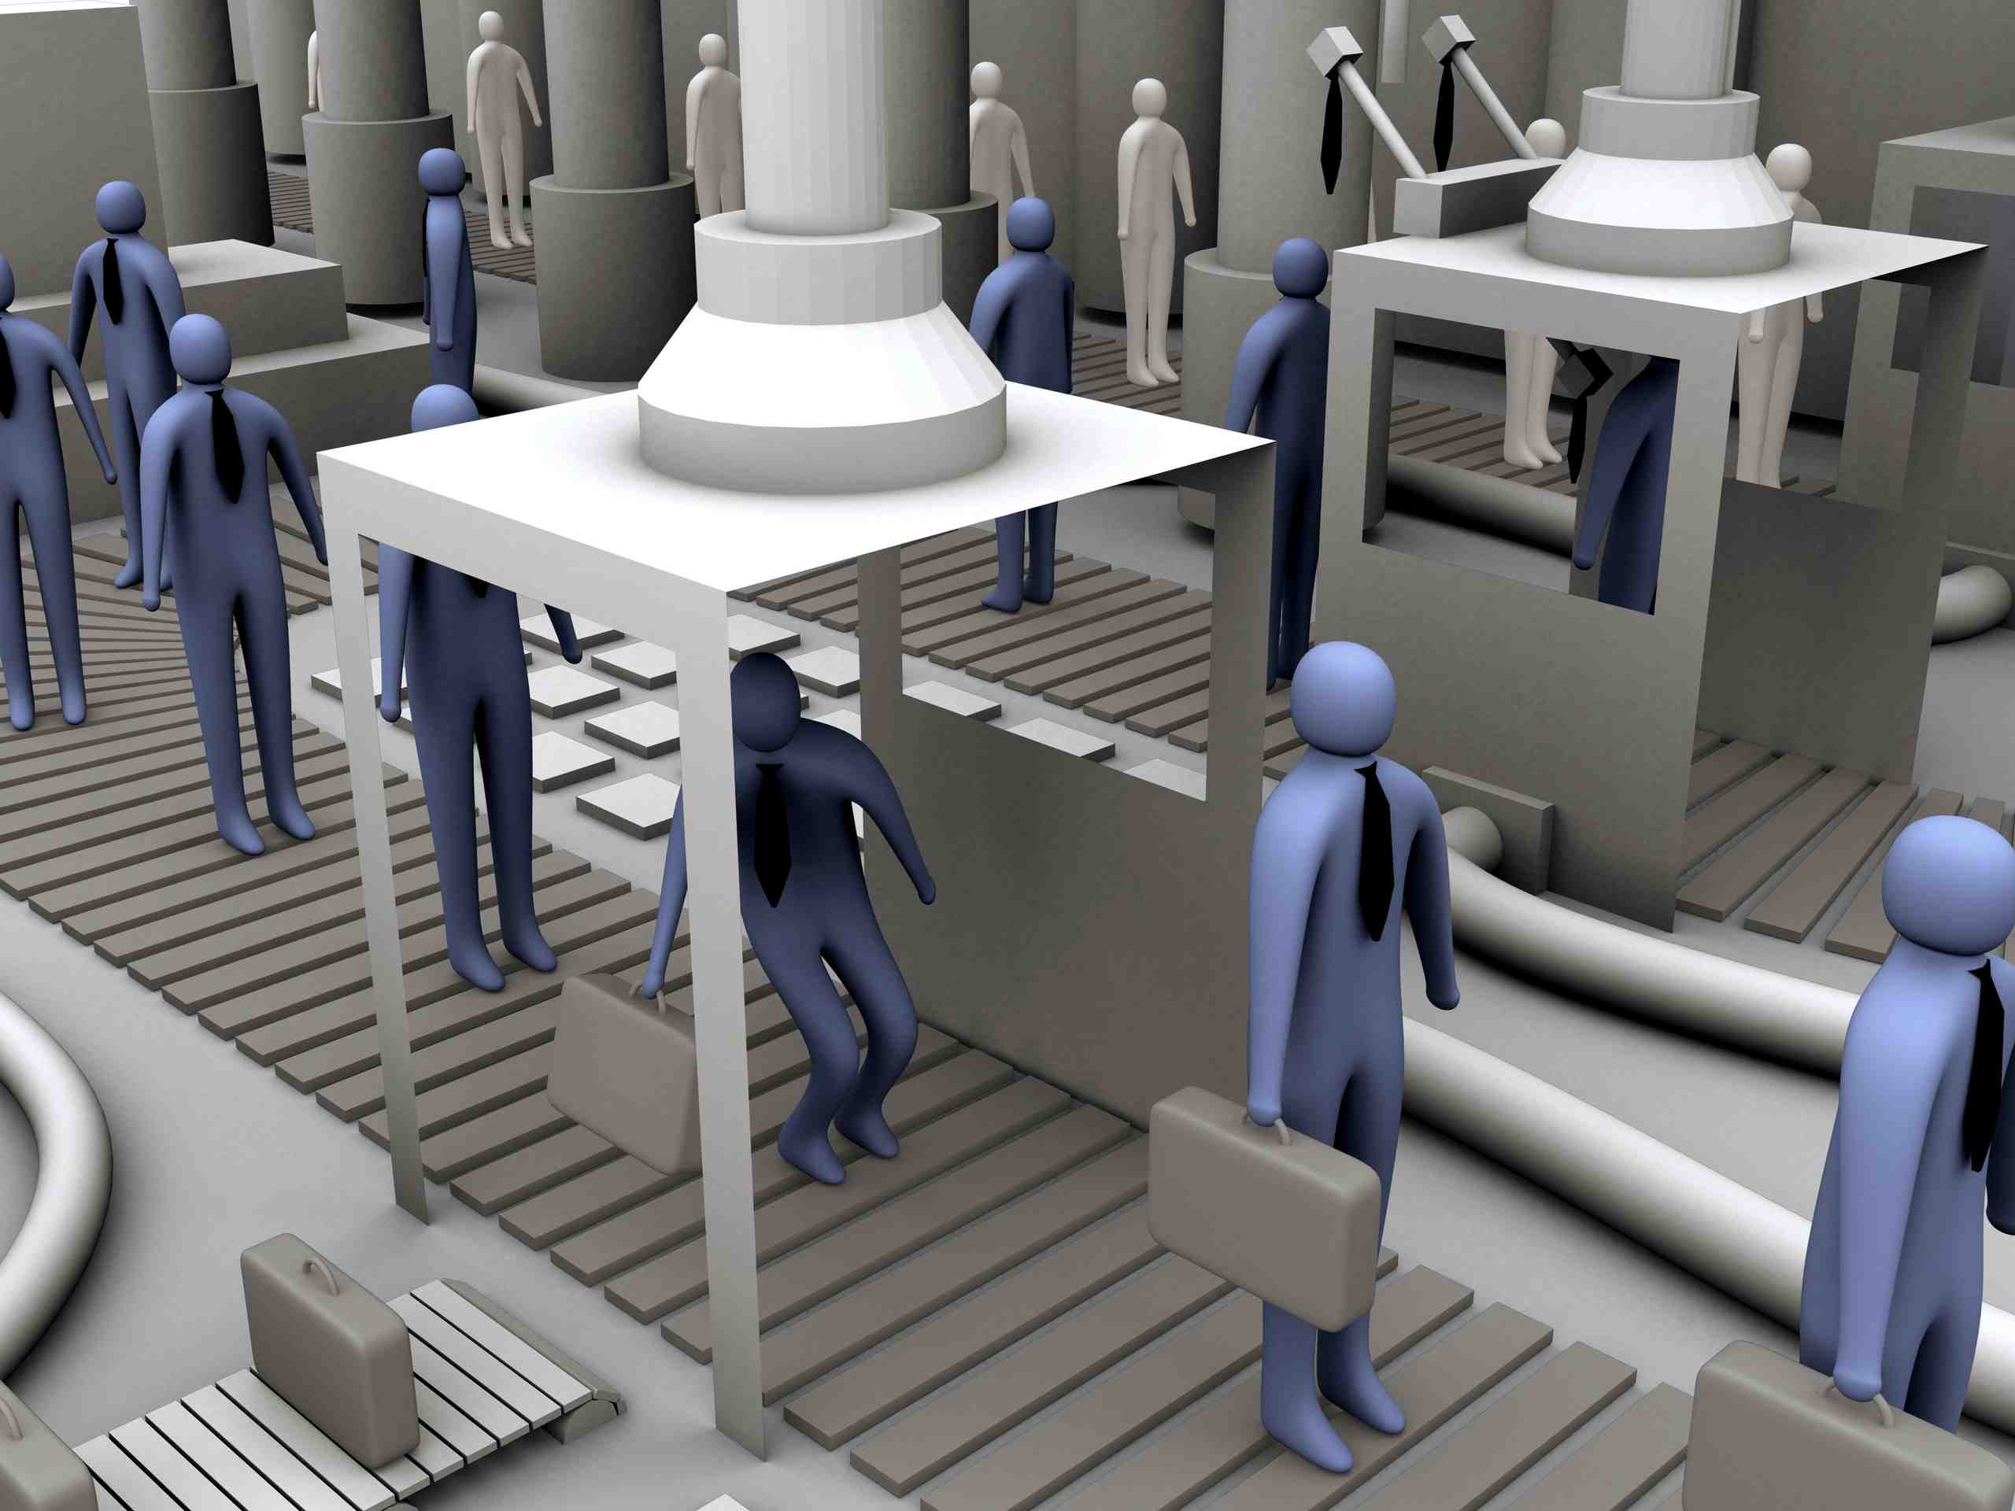

Object Oriented Programming

Slide 2

What……………….?
OBJECT-ORIENTED PROGRAMMING (OOP) is a programming paradigm that attempts to design and build computer programs the same way people think about and deal with the world.
An object-oriented program may be considered a collection of interacting objects. Each object is capable of sending and receiving messages, and processing data.

Slide 3
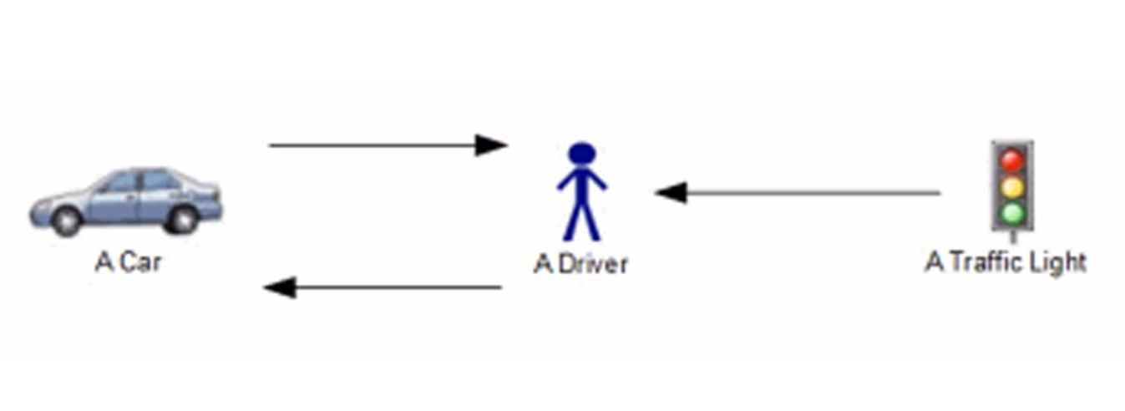
When the traffic light changes, it sends a virtual message to the driver.
The driver receives the message, and then chooses to accelerate or decelerate. This sends a virtual message to the car
When the car's speed changes, it sends a virtual message back to the driver, via the speedometer.

Slide 4
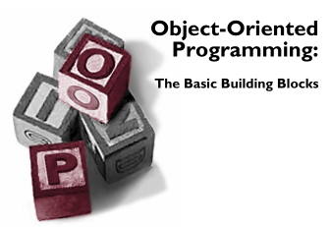
Fundamental concepts of OOP……..
CLASS
OBJECT
METHOD
MESSAGE PASSING
INHERITANCE
ABSTRACTION
ENCAPSULATION
POLYMORPHISM

Slide 5
CLASS…………….?
A class is the blueprint from which the individual objects are created.
It includes-
attributes (its fields or properties) and the things it can do (behaviours, methods, operations or features).
A class defines the characteristics of an object.

Slide 6
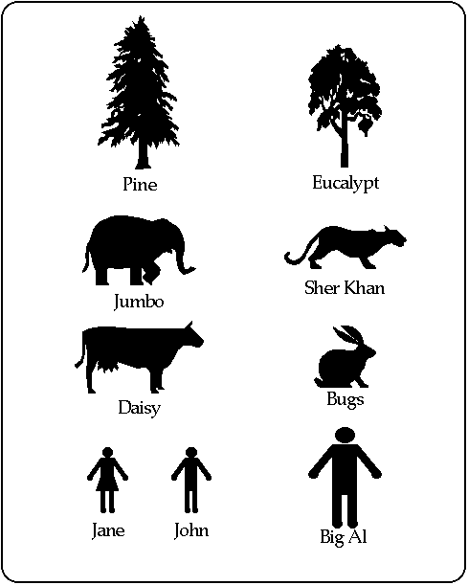
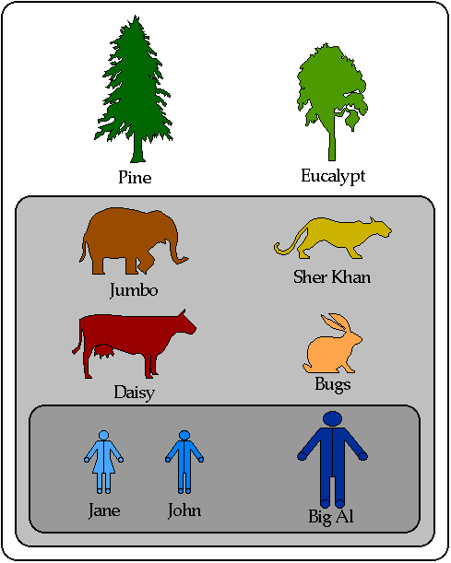
Consider class………….

Slide 7
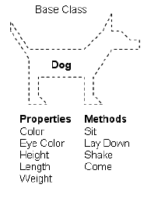
Example……………
Dog is a class with
Attributes: color, Eye color, Height, Length, weight
Behaviours: Sit, Lay down, Shake, Come

Slide 8

OBJECT…………?
Objects are
– entities that have behaviours, that hold information, and that can interact with one another.
In pure OOP terms an object is an instance of a class.

Slide 9
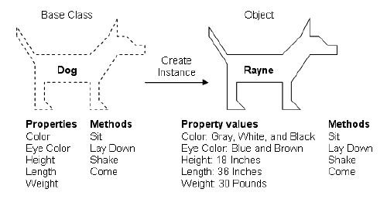
Example
Rayne was an instance of the Dog class
A class serves as the blueprint for an object.

Slide 10
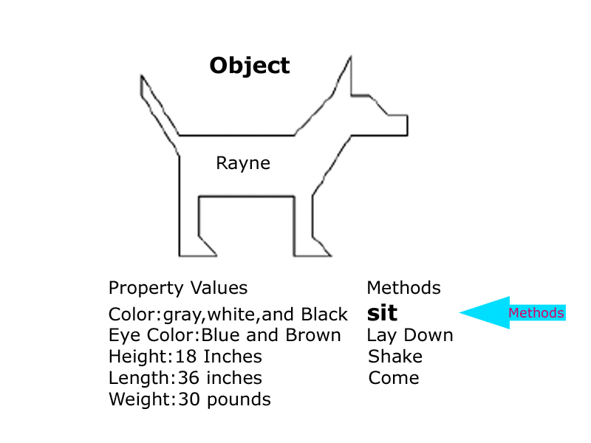
METHOD…………..?
Method is behavior of an object
Methods define the abilities of an object
Method usually affects only one particular object.

Slide 11
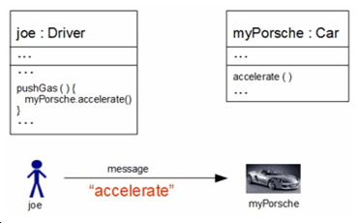
MESSAGE PASSING…………..?
Message passing (or method calling) is the process where an object sends data to another object to invoke a method.
The object called "joe" (an instance of the driver class), presses the gas pedal,
he literally passes an accelerate message to object "my Porsche“, which in turn, invokes the "my Porsche" accelerate method

Slide 12
INHERITANCE……………..?
Inheritance can be defined as the process where one object acquires the properties of another.
A subclass(child) is a specialized version of a class, which inherits attributes and behaviours from the parent class
A child may also have additional unique behaviours and properties of its own that its parent does not have.

Slide 13
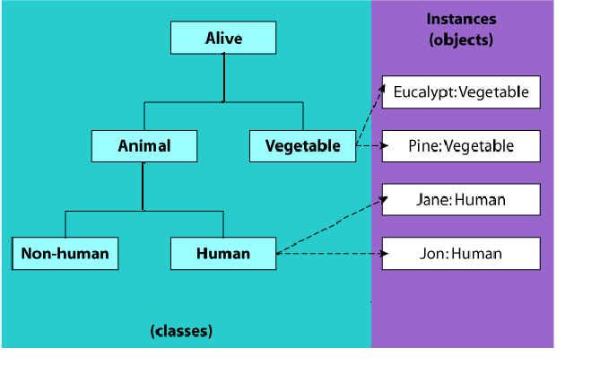
INHERITANCE……………..?

Slide 14
INHERITANCE……………..?
Animal (a child of Alive) inherits all the properties of being Alive (the parent of Animal).
A Human inherits all the properties of being an Animal and therefore also all the properties of being Alive
A Human has some extra properties that allow us to classify it as a Human that are not necessarily true of all things that are Animals.
The object of “Human“ say “Jon” may be instantiated from class “Human" instead of class “Animal“ or “Alive”.

Slide 15

ABSTRACTION…………….?
I do not Know How the engine will work, Iam only a poor driver, Hide all the working from me Oh!
Abstraction is the practice of reducing details so that someone can focus on a few concepts at a time
Abstraction is "To represent the essential feature without representing the background details.“
Abstraction is the process of hiding the working style of an object, and showing the information of an object in an understandable manner.

Slide 16
ENCAPSULATION……………….?
The encapsulation is the inclusion within a program object of all the resources need for the object to function - basically, the methods and the data.
Think of encapsulation as a black box; data is sent to a method, a lot of work goes on using the data, of which you don't know or care about. An output is returned to the caller. That is the process of encapsulation, or information hiding.
Encapsulation guarantees the integrity of the data contained in the object by preventing users from changing internal data into something invalid.

Slide 17
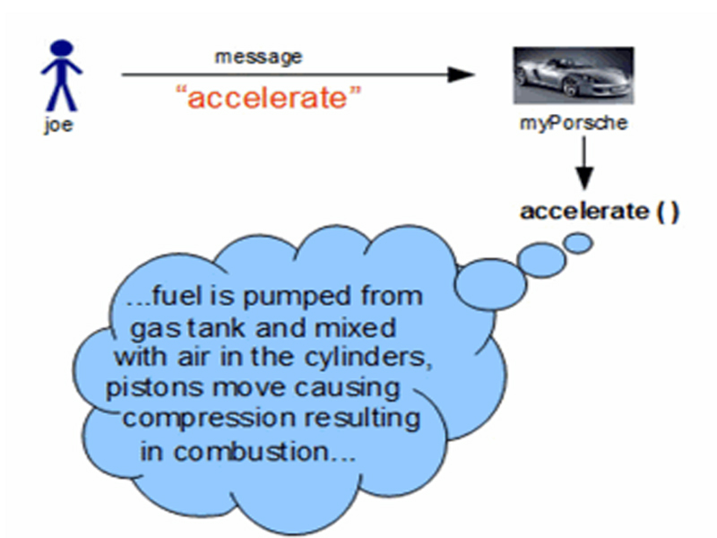
ENCAPSULATION……………….?
Joe does not bother about what is happening in the method accelerate()
Joe can not change the internal data of the object myPorsche

Slide 18
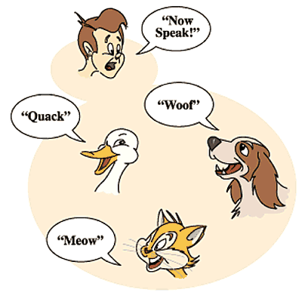
POLYMORPHISM…………..?
The Word polymorphism comes from Greek and means having several different forms.
An object behaves differently at different place is called polymorphism.
Polymorphism is briefly described as "one interface, many implementations.

Slide 19
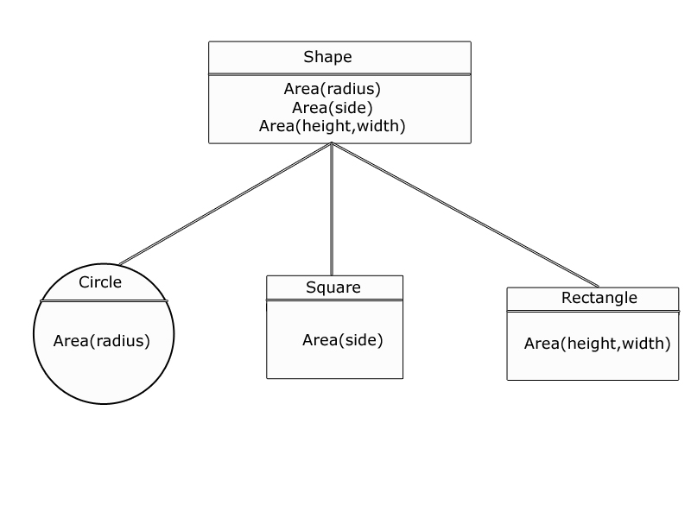
POLYMORPHISM…………..?
Method overloading:
same method with different signature (number or type of arguments)
Class shape has a method Area with different argument. The object of each subclass will call the appropriate method they want to execute.

Slide 20
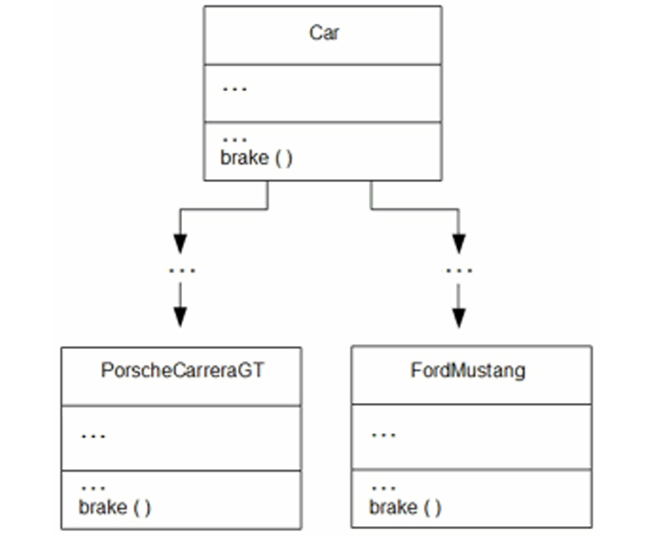
POLYMORPHISM…………..?
Method overriding:
In a class hierarchy, when a method in a subclass has the same name and type signature as a method in its super class, then the method in the subclass is said to override the method
in the super class.
Classes "Porsche Carrera GT" and "Ford Mustang" both inherited a method called "brake" from a similar parent class. The results of executing method "brake" for the two types produces different results.

Slide 21
ABSTRACT CLASS……………..?
Abstract classes are used to declare common characteristics of subclasses.
An abstract class cannot be instantiated. It can only be used as a super class for other classes that extend the abstract class.
A parent class contains the common functionality of a collection of child classes, but the parent class itself is too abstract to be used on its own.
An abstract class can contain fields that describe the characteristics and methods that describe the actions that a class can perform.

Slide 22
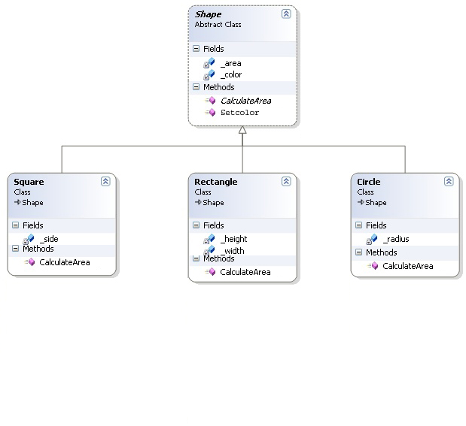
ABSTRACT CLASS……………..?
Shape is an abstract class which contains some fields and methods. This abstract class is inherited by subclasses Square, Rectangle and Circle.
We declare Shape class as abstract because there is no such “thing” as a generic shape. There can only be concrete shapes such as squares, circles, triangles etc. The method CalculateArea is an abstract method and this abstract method is implemented in the subclasses.

Slide 23
INTERFACE……………………?
Interface can be used to define a generic template and then one or more abstract classes to define partial implementations of the interface.
Interfaces just specify the method declaration. The method in the interface is implemented in the subclasses.
Interface definition begins with the keyword interface. An interface like that of an abstract class cannot be instantiated.

Slide 24
ABSTRACT CLASS………..INTERFACE
Interface definition begins with a keyword interface so it is of type interface.
Abstract classes are declared with the abstract keyword so it is of type class .
Interface has no implementation, but they have to be implemented.
Abstract class’s methods can have implementations and they have to be extended.
Interfaces can only have method declaration ( public and abstract) and fields ( public static).
Abstract class’s methods only when declared abstract.
Interface can inherit more than one interfaces.
Abstract class can implement more than one interfaces, but can inherit only one class .

Slide 25
Summary
We discussed key concepts of object orientation C#. Basics of OOPS including Interfaces, Access Modifiers, inheritance, polymorphism etc.
The skeleton of object - oriented programming is of course the concepts of class.
OOP concepts such as abstraction and polymorphism help to define better object models where object hierarchies are designed with reusability in mind.

Slide 26

Questions?

Slide 27
THANK YOU

